Slide 1
GERAS
Abdelmounaim DEBIECHE

Slide 2
Agenda
Level of abstraction
Typical scenarios for elderly people
Proposal: A DSL for handling these scenarios
Conclusions & Perspectives
Notes:
I will provide a broad overview of ThingML, present some challenges and interesting features that are missing in ThingML and suggest some potential contributions of our own.

Slide 3
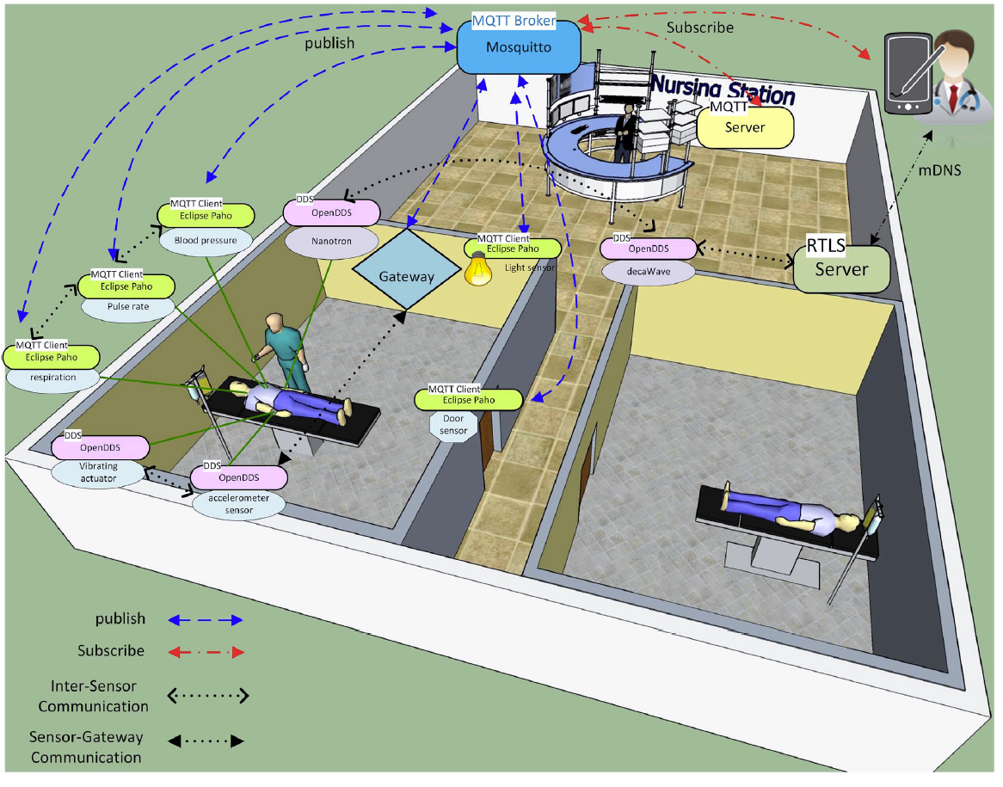
A Classic IoT Systems

Slide 4
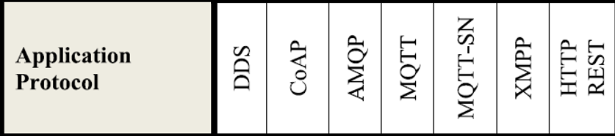
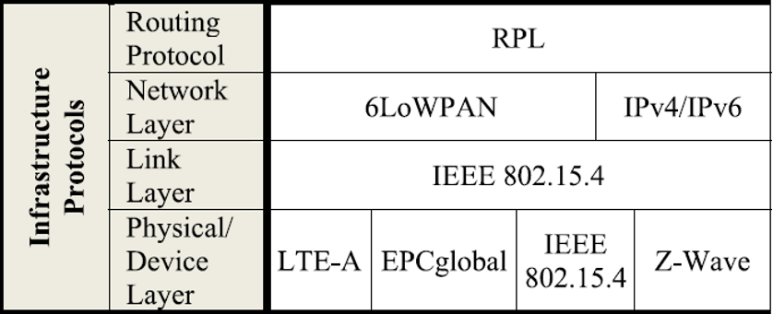

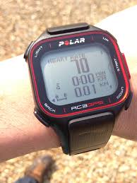
Level of abstraction
Business Layer
GERAS
Application Layer
Application Layer
Service Management
Infrastructure Layer
Object Absetraction
Objects

Slide 5
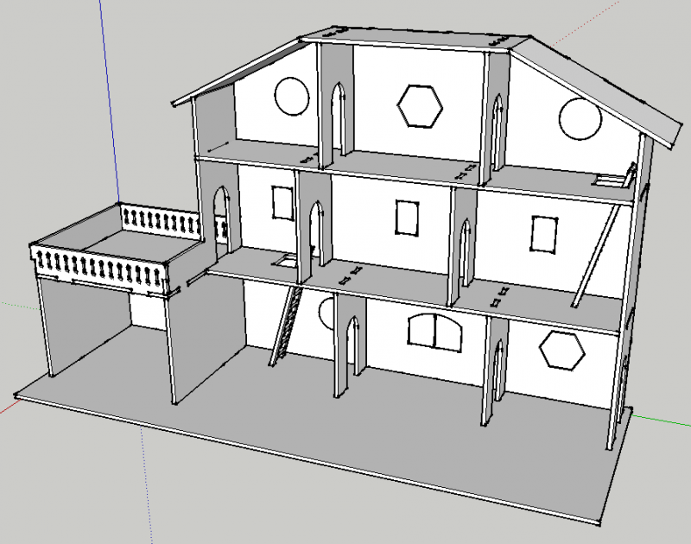

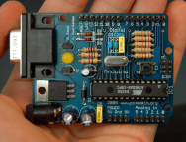
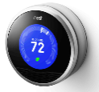
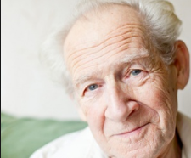
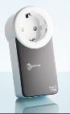



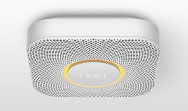

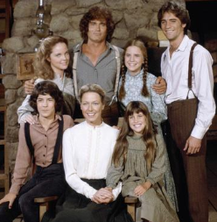

SmartHome for Elderly People
What happen if I fall and become unconscious?
What happens if I do not hear a sound of phone ringing?
What happens if I forget to close the door?

Slide 6
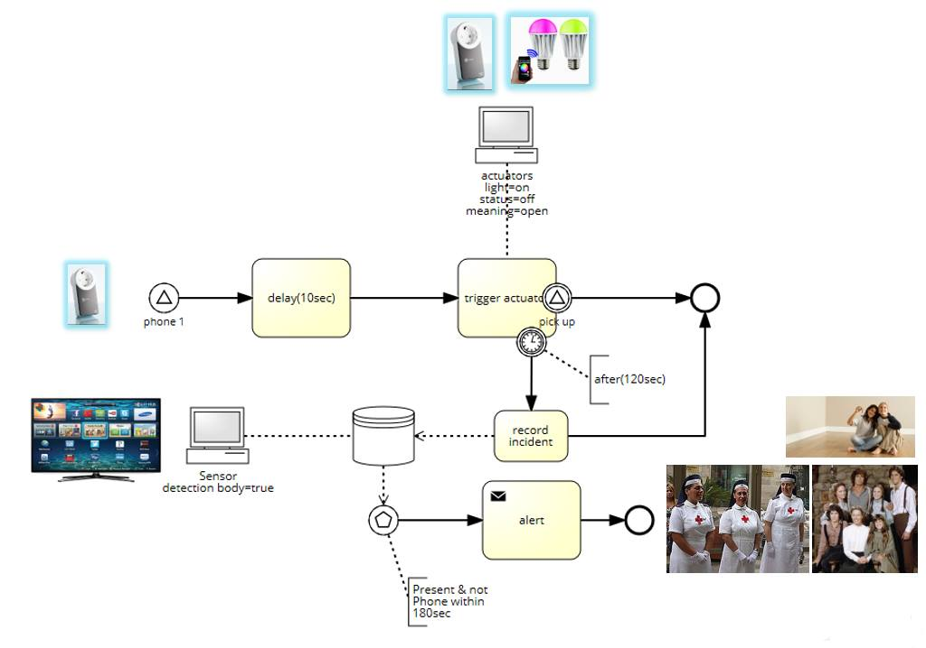
Scenario as Activity Diagrams

Slide 7
A Dsl for handling scenarios
Device Type Declaration
Network Configuration
Business Rules

Slide 8
Type Declaration
enumeration Volume {V1; V2; V3;}
device Phone{
sensing receiveCall()
actuating ring(volume:Volume)
actuating setVolume(volume: Volume)
sensing pickedUp()
}
device LightBulb{
actuating on()
actuating off()
actuating blink()
}
device Timer{
actuating reset()
actuating set(delay : Volume)
sensing timeout()
}
device AlertDB{
actuating declareIncident(msg:string)
actuating alert()
}
device BodyDetector{
sensing detect()
actuating isPresent()
}
gateway Central

Slide 9
Network Configuration
configuration MyHome{
node gw : Central
node entranceBulb : LightBulb
node bathroomBulb : LightBulb
node kitchenBulb : LightBulb
node roomBulb : LightBulb
node ipPhone : Phone
node db : AlertDB
node bodydetector : BodyDetector
node timer : Timer
from entranceBulb to gw via IP
from bathroomBulb to gw via IP
from kitchenBulb to gw via IP
from roomBulb to gw via IP
from ipPhone to gw via IP
}

Slide 10
Business Rules
rule WaitBeforeBlink :
when (ipPhone.ring()) do {
timer.reset()} ; timer.set(10)
}
rule BlinkAndWait:
when (timer.timeout()) do {
LightBulb.blink()
||
(timer.reset() ; timer.set(120))
}
rule PickedUpQuick:
when (ipPhone.pickedUp()) do{
LightBulb.off()
}
rule NotPickedUpAfterBlinking:
when (timer.timeout()) do{
db.declareIncident(predefinedAlert)
||
bodydetector.detect()
||
timer.reset() ; timer.set(60)
}
rule Alert:
when (timer.timeout() and bodydetector.present()) do {
db.alert()
}

Slide 11
Conclusion
Level of abstraction
Scenario

Slide 12
Proposal
DSL
SCENARIO
Prototype

Slide 13
Question
Could we reuse/extend ThingMl?

